Slide 1
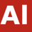
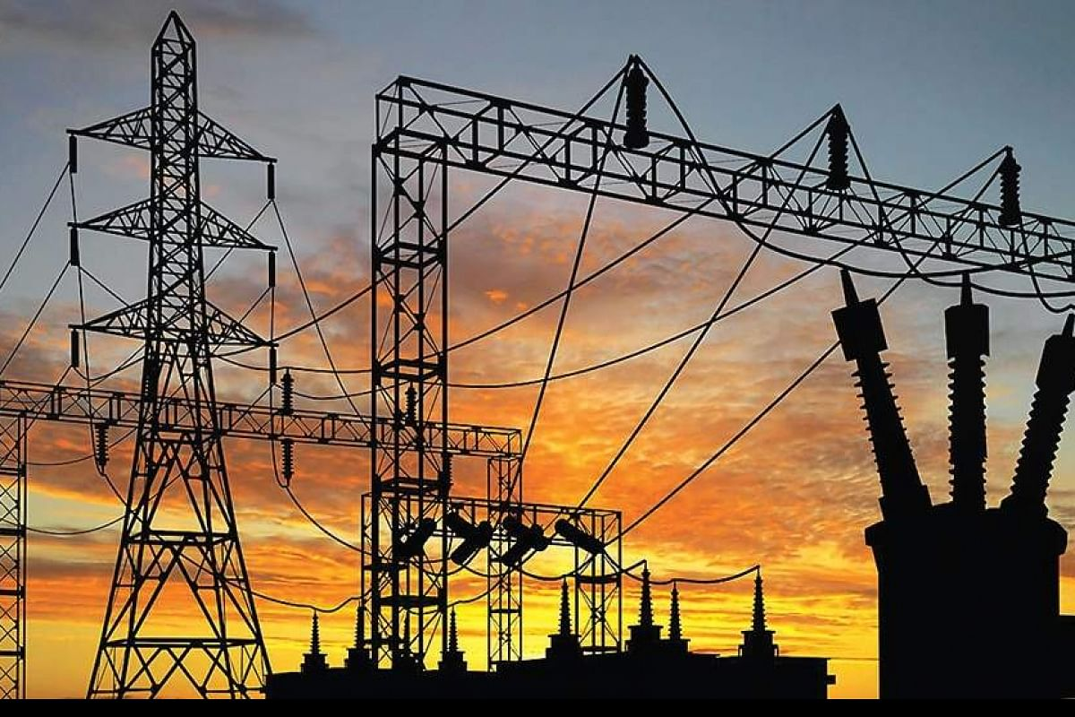
Appliance
Energy
Prediction
V Rupesh Kumar Patro
Shashank Maindola

Slide 2
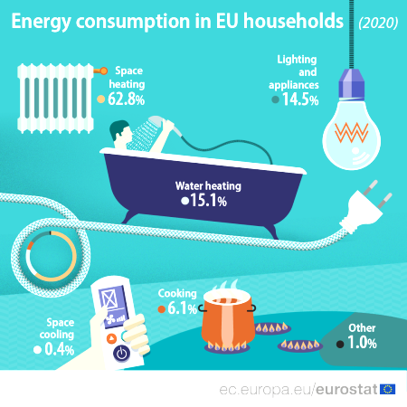
Introduction
In this century, the world is being driven towards more cleaner means of energy. The electricity generated using the renewable sources plays a major role. But simply generating and utilizing the electrical energy is not viable, any extra generation will lead to non utilization and less generation will lead to power outages. Hence, we need demand side and supply side management so we can flatten the generation distribution curve. The residential load contributes to 27% of the total energy consumption (Source::Eurostat). Residential household consumption is generally governed by weather conditions. Here we have a data of one of e residential building in Belgium and using the machine learning techniques we have to figure out which algorithm give the best output.
Few of the salient features of our dataset:-
There are 29 columns and 19735 rows in our dataset.
Max energy usage of appliance is 1080 and min is 10 watt
light column having majority of the data 0 values
Max pressure outside house is 772.3 mm_hg
Except date column There is none categorical column in the dataset.
Average temperature outside is about 7.5 degrees. While it ranges from -6 to 28 degrees.
There is no null or missing values.
Average humidity outside is higher than average humidity inside.
Max wind speed is 14 m/s

Slide 3
EDA
Feature Engineering
Pre Processing
Clean up
Model Implementation
Model Explanation
Appliance Energy Prediction using Machine learning

Slide 4
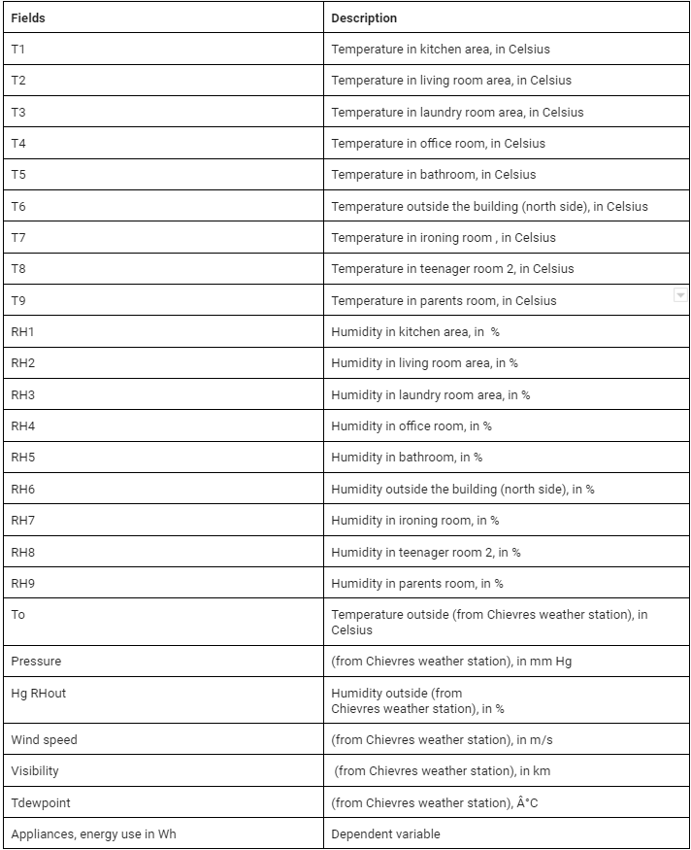
Exploratory Data Analysis(EDA)
We are provided with the data of 4.5 months for a household collected every 10 minutes using zigbee network. It contains temperature and humidity of different rooms, light and appliance energy consumption parameters of the household . We are also provided with visibility, atmospheric pressure, relative humidity, visibility, Dewpoint collected from Chievres weather station, Belgium

Slide 5
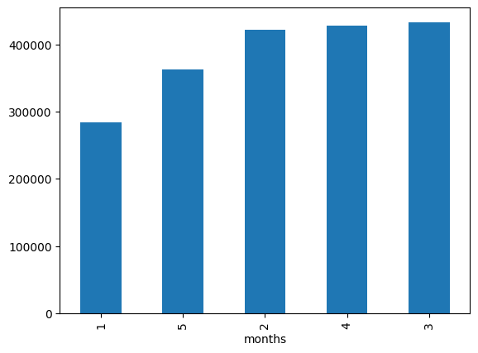
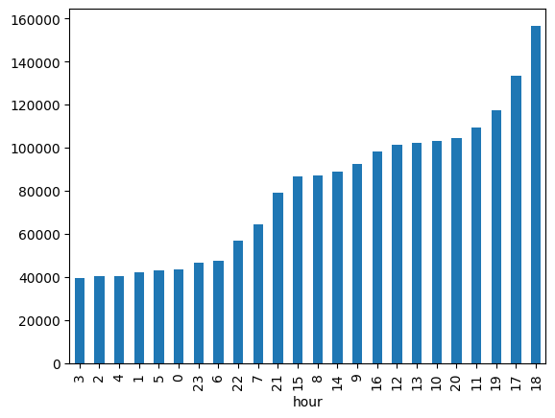
Total Monthly Energy consumption
Total Hourly Energy Consumption

Slide 6
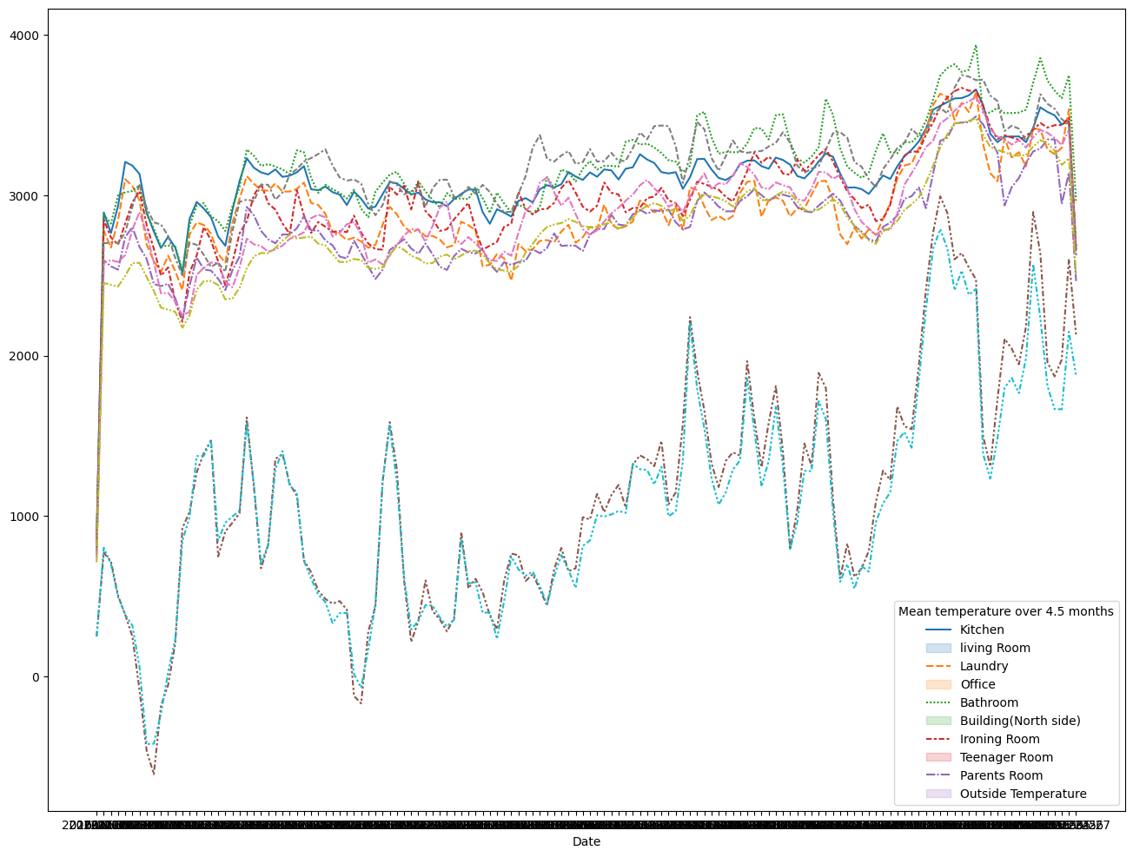
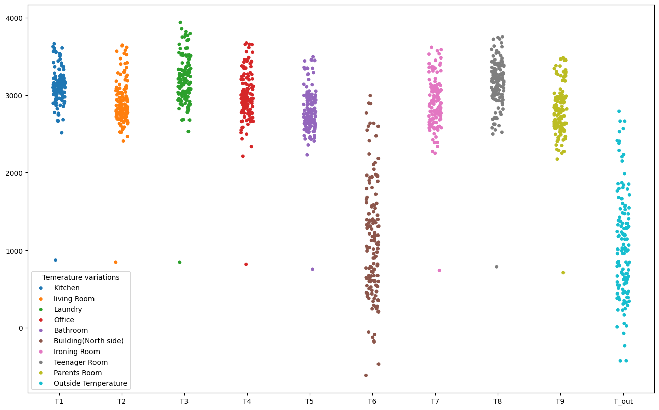
Household and outside temperature

Slide 7
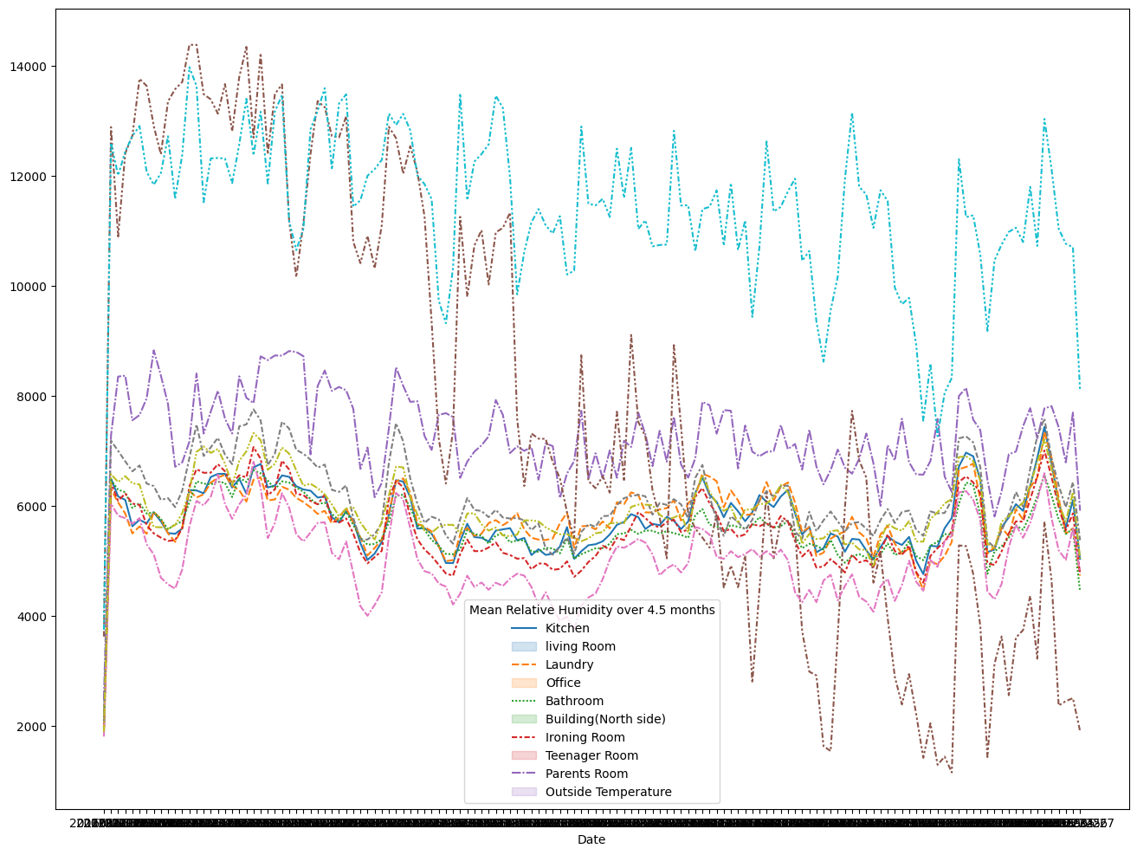
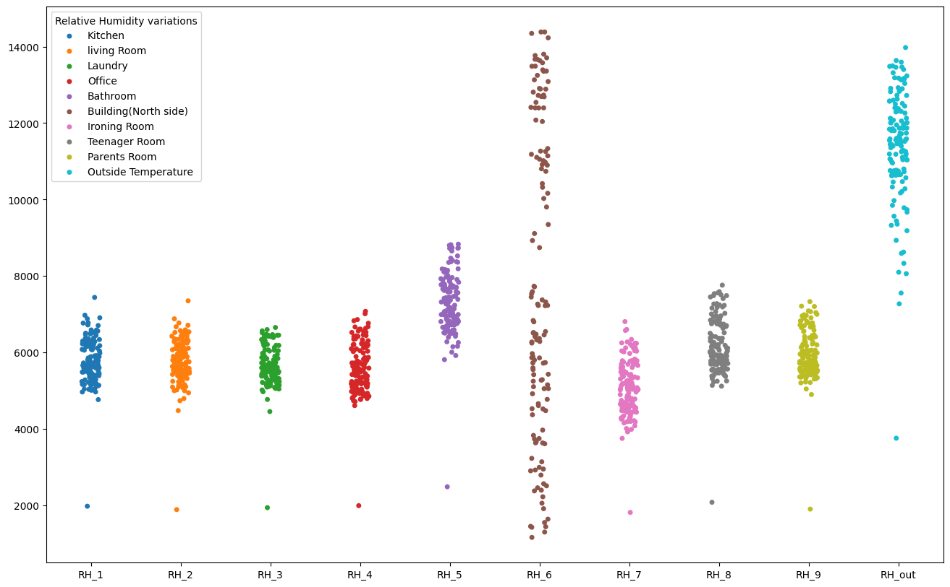
Household and outside Humidity

Slide 8
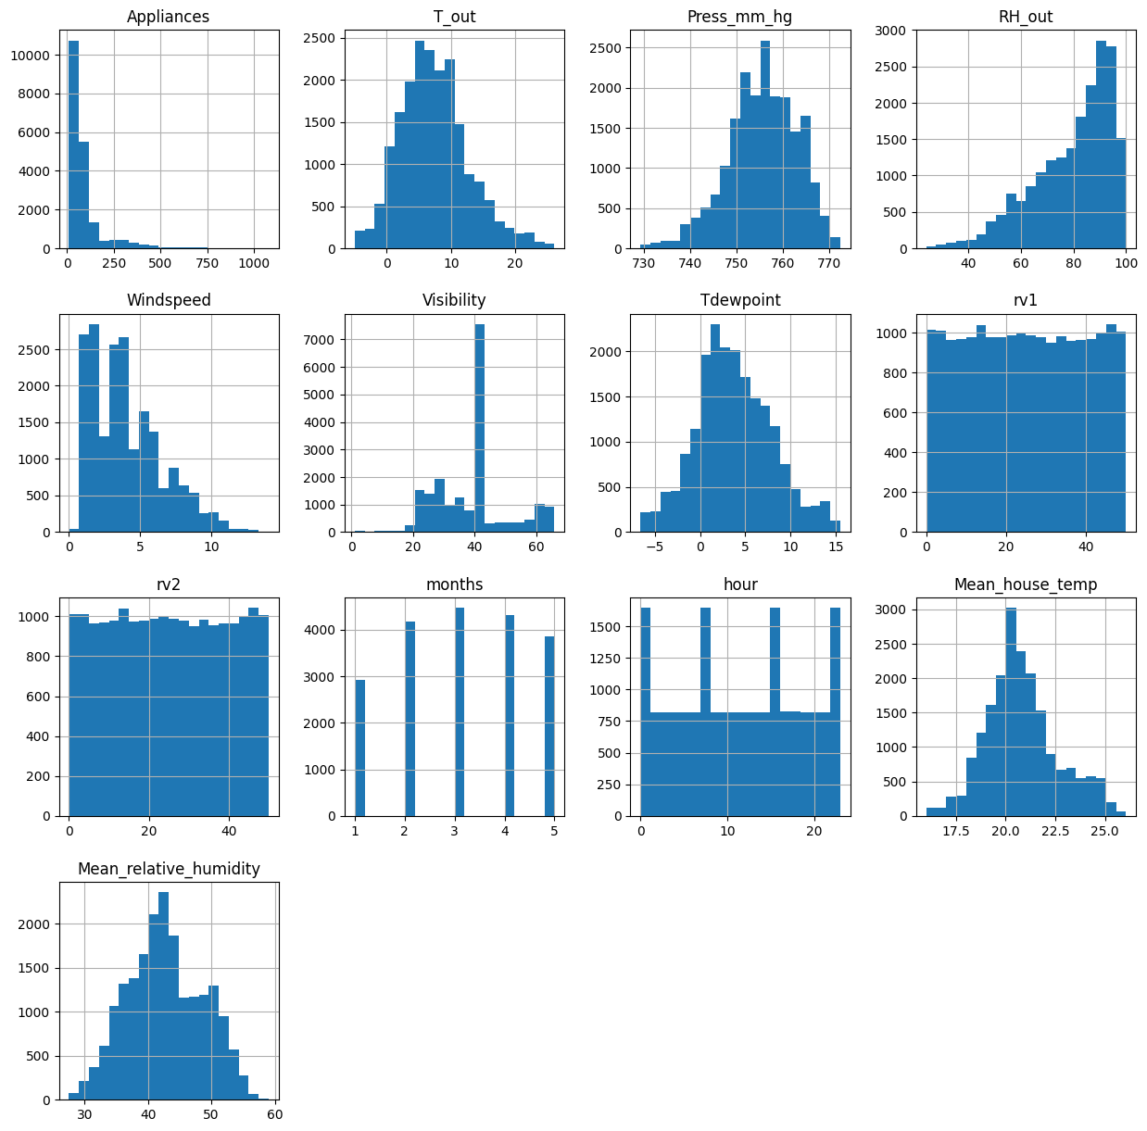
Distribution of all the parameters

Slide 9
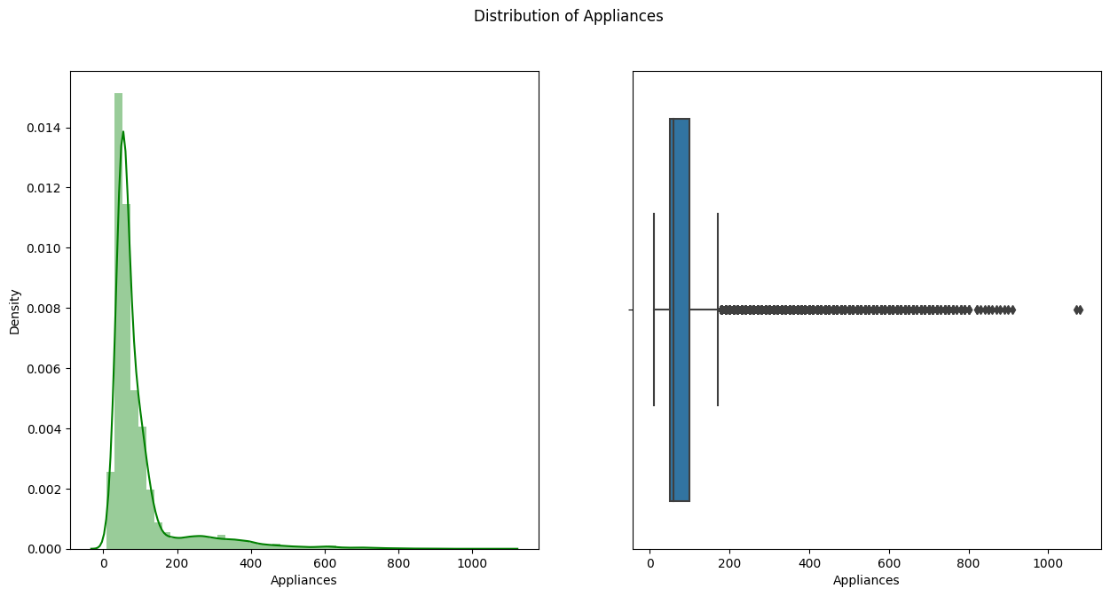
Distribution of Appliance Energy Consumption

Slide 10
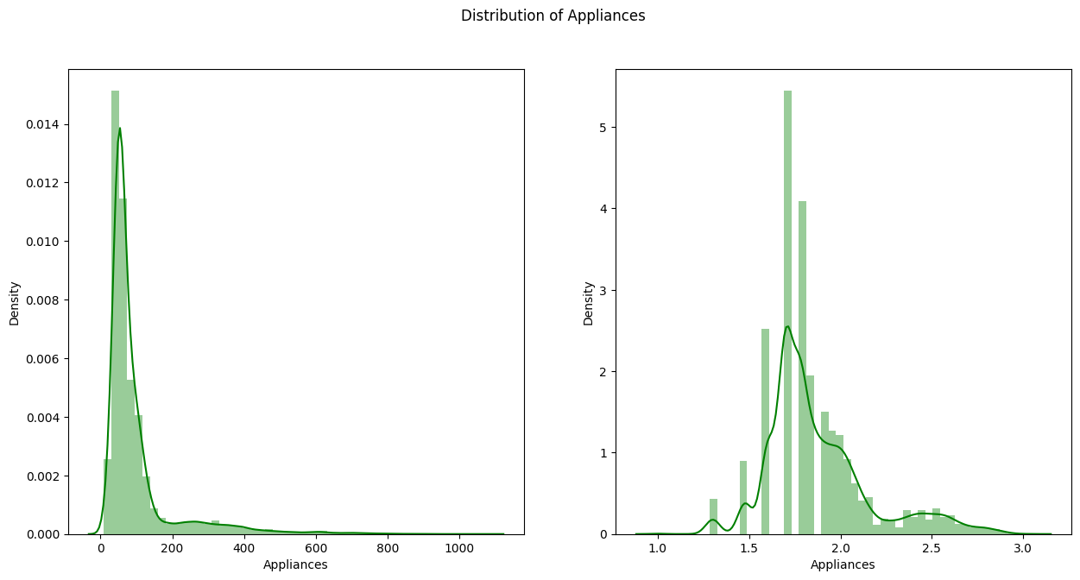
Our graph is moving towards to y axis as it is positively skewed and we couldn't get any better visualization with these type of graph. Hence we took Log or Square Root or Exponential of the dependent variable and draw the graph.

Slide 11
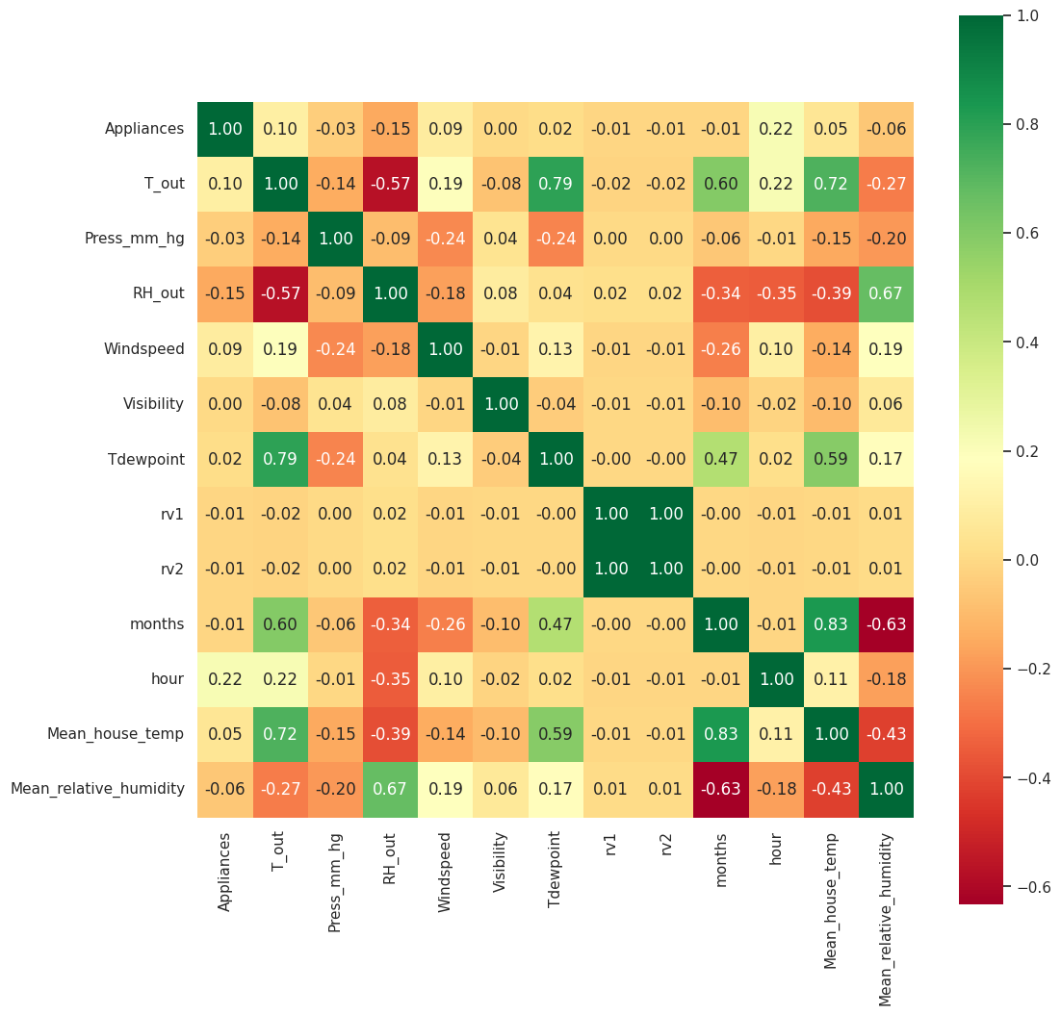
Correlation Plot

Slide 12




Temperature and Humidity
The northside temperature as it is similar to north side temperature, hence it verifies that sensor was working perfectly and the data gathered is valid. The temperature inside is more or less same.
There is a variation in relative humidity of Building (North side) and Outside. The outside humidity is from airport weather sensor so the humidity can be different while the temperature outside the building is different due to the neighborhood factors like landscaping etc., hence we will be ignoring the relative humidity data from the airport.
Seasonal and Hourly consumption Pattern
It is clearly understood that march has the maximum energy consumption.
The maximum power consumption is around evening while the least consumption is around the early morning hours.
Observations
Distribution
Press_mm_hg, Visibility, TDewpoint, rv1, rv2, Mean_house_temp, Mean_relative_humidity,months, hour are normal distributed data.
Positively skewed(>1):- Appliances.
Moderately Positively skewed(0.5 to 1):- T_out, Windspeed.
Normal Distributed(-0.5 to +0.5):- Press_mm_hg, Visibility, Tdewpoint, rv1, rv2, Mean_house_temp, Mean_relative_humidity, months,hour.
Negative skewed(-0.5 to -1):- RH_6.
Target Variable
Dependent variable is right skewed and lot of outliers present in our data set but they are not ignored at there are sometimes situations when the consumption increases here we see there are lot of such instances.
There is positive correlation between temperature inside and outside with the appliance energy consumption.
There is low correlation of appliance energy consumption with other variables

Slide 13
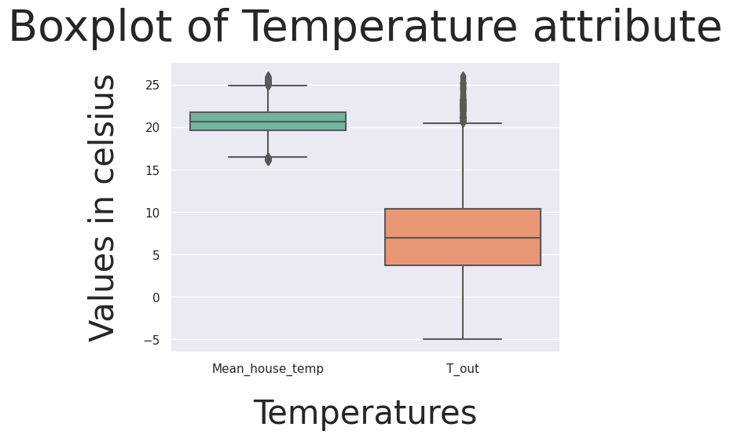
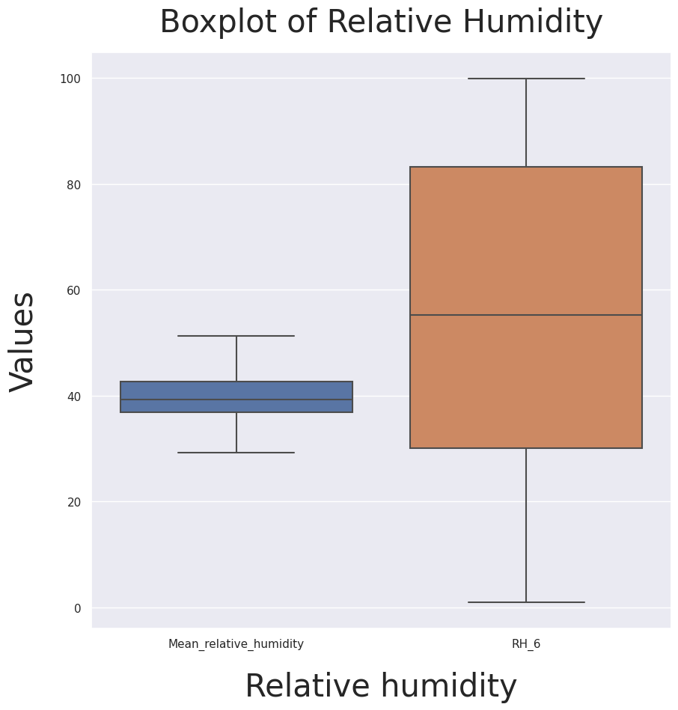
Clean Up
Number of outliers
Appliances 2138
T_out 436
Press_mm_hg 219
RH_6 0
Windspeed 214
Visibility 2522 Tdewpoint 10
rv1 0
rv2 0
months 0
hour 0
Mean_house_temp 512 Mean_relative_humidity 0

Slide 14
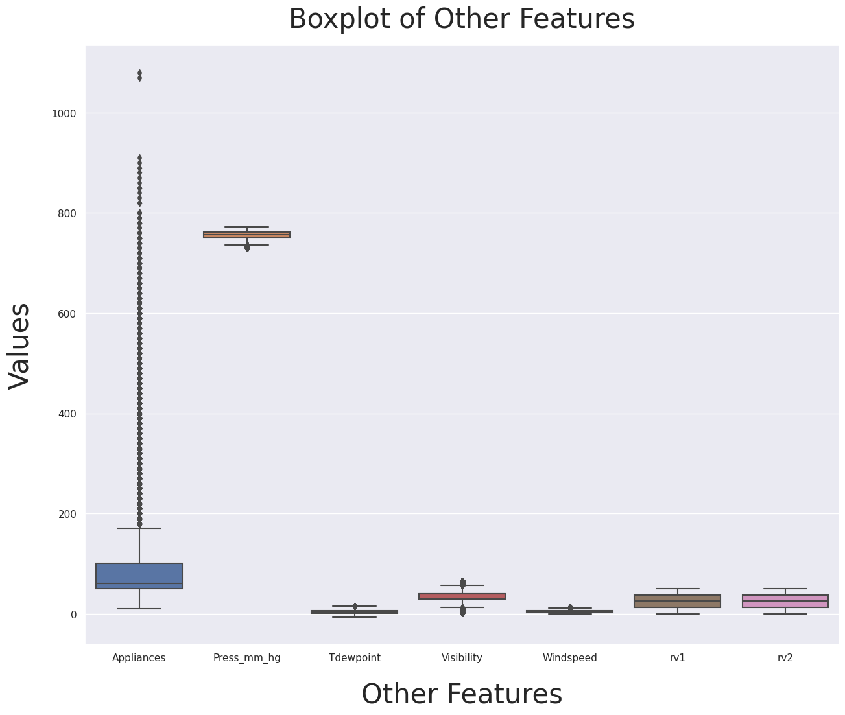
Firstly, we removed certain features like temperature in individual rooms, humidity in individual rooms and replaced them with the mean values for faster model training. We ignored the humidity in the bathroom and humidity at the airport as humidity in bathroom will always be higher than rest of the house and humidity of the airport doesn’t represent the humidity of the neighborhood. Temperature outside is almost same as temperature of the northside of the building hence we will ignored temperature out side building. We removed r1 and r2 features as they have infinite VIF. We also removed light feature from our data set.
Secondly, we observe that there are a lot of outliers in visibility and appliance but we will not remove them as there are conditions when there is spike in demand and they are realistic hence we will not ignore them. Rest of the feature have little outliers so we will not remove them

Slide 15
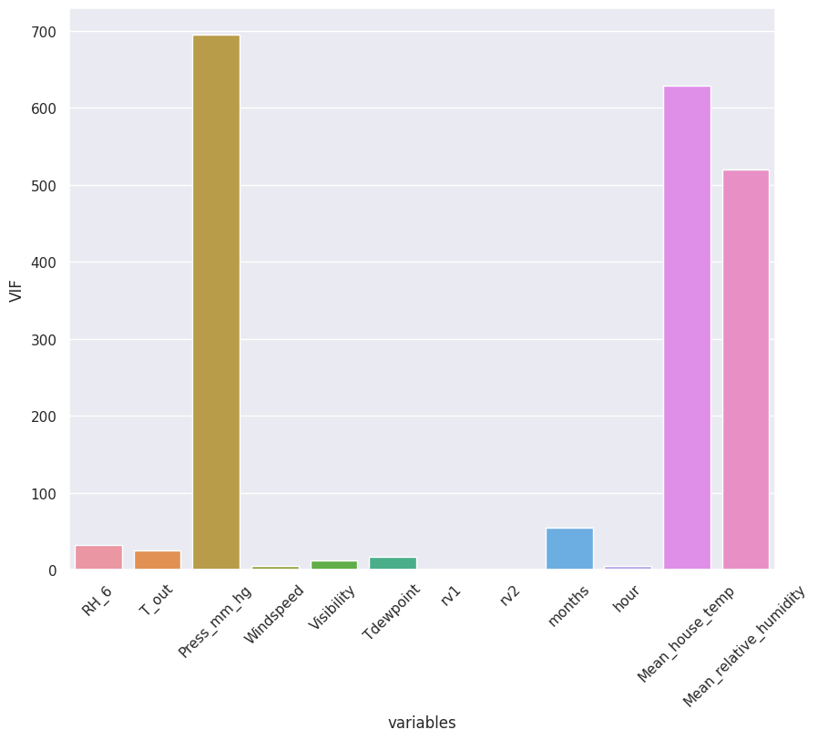
Feature Engineering
VIF
RH_6 32.20155615335796
T_out 24.95561180861631
Press_mm_hg 694.2964804113375
Windspeed 5.005980999514861
Visibility 11.771630692843596
Tdewpoint 17.168244694540604
rv1 Infinity
rv2 Infinity
Months 53.95771288882704
Hour 4.7905065440715555
Mean_house_temp 627.8826782455517
Mean_relative_humidity 519.4920680561612
rv1 and rv2 has infinite Variance Inflation Factor hence we will remove them

Slide 16
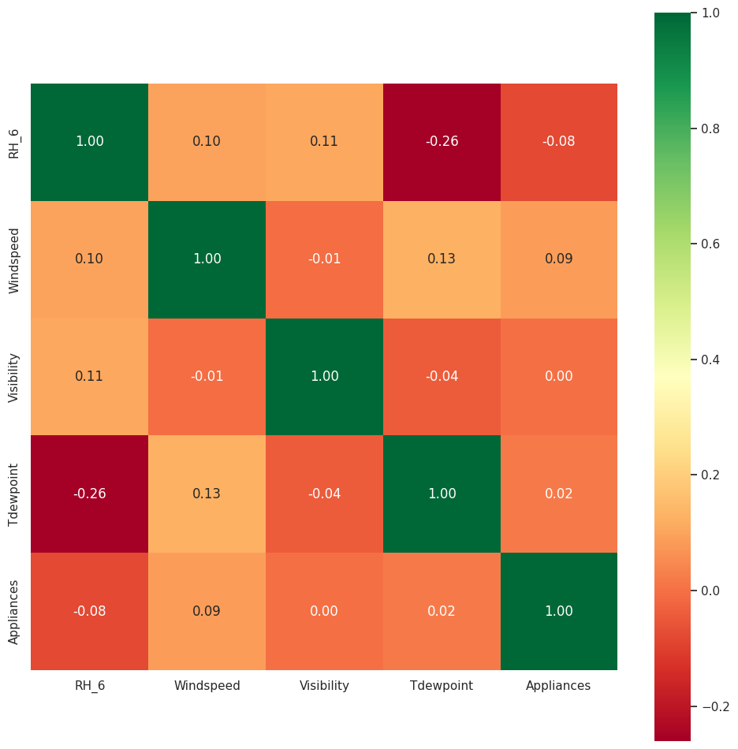
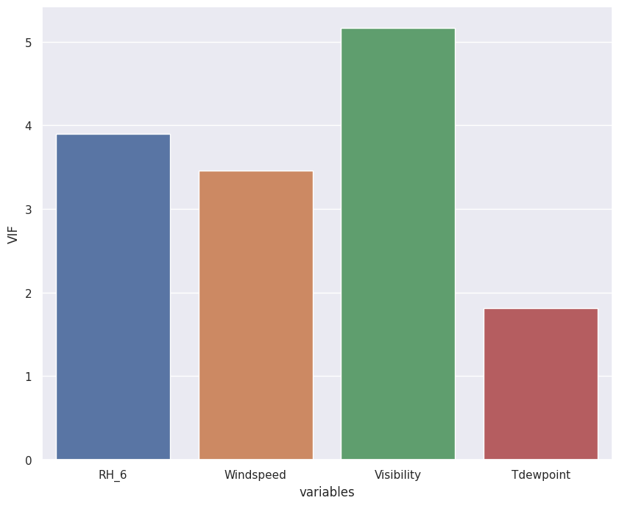
VIF
RH_6 3.8924680552202884
Windspeed 3.458756352856162
Visibility 5.159889820397968
Tdewpoint 1.8151746899474195
Multicollinearity
Moderate
Moderate
High
Moderate

Slide 17
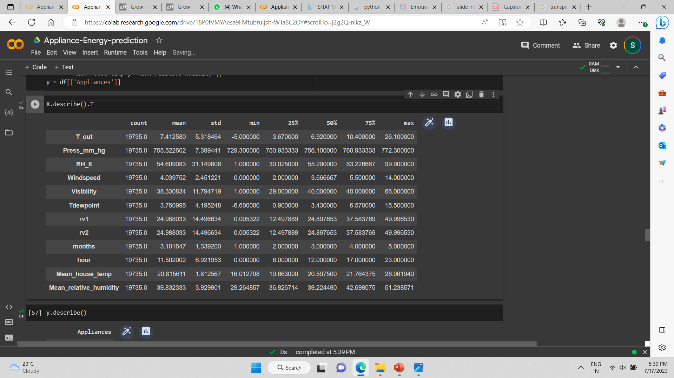
Pre Processing
Our final dataset for model training is split into two one which containing the features for model training(X) and the target variable(y). The two data set are also divided using 20:80 split for training and test the model
For feature scaling we used standardization using standard scalar.

Slide 18
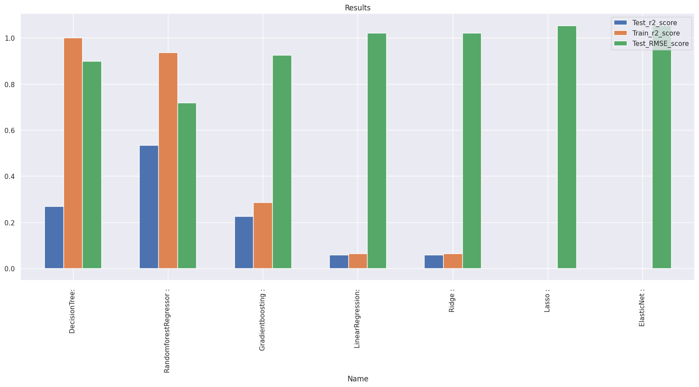
Model Implementation
So after training data Random Forest Regressor has the least RMSE score and a decent R2 score.
Before proceeding to try next models, we try to tune some hyperparameters and see if the performance of our model improves.
Hyperparameter tuning is the process of choosing a set of optimal hyperparameters for a learning algorithm.

Slide 19
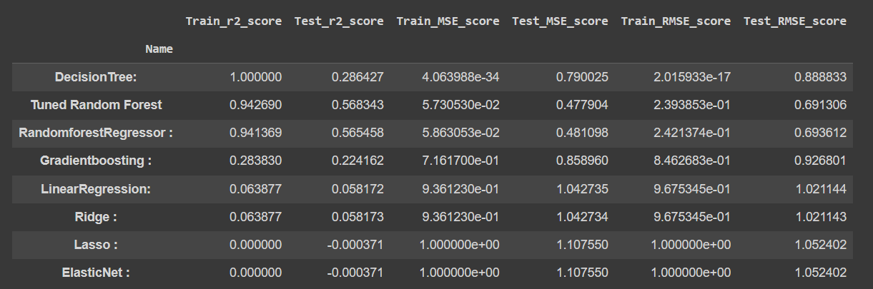
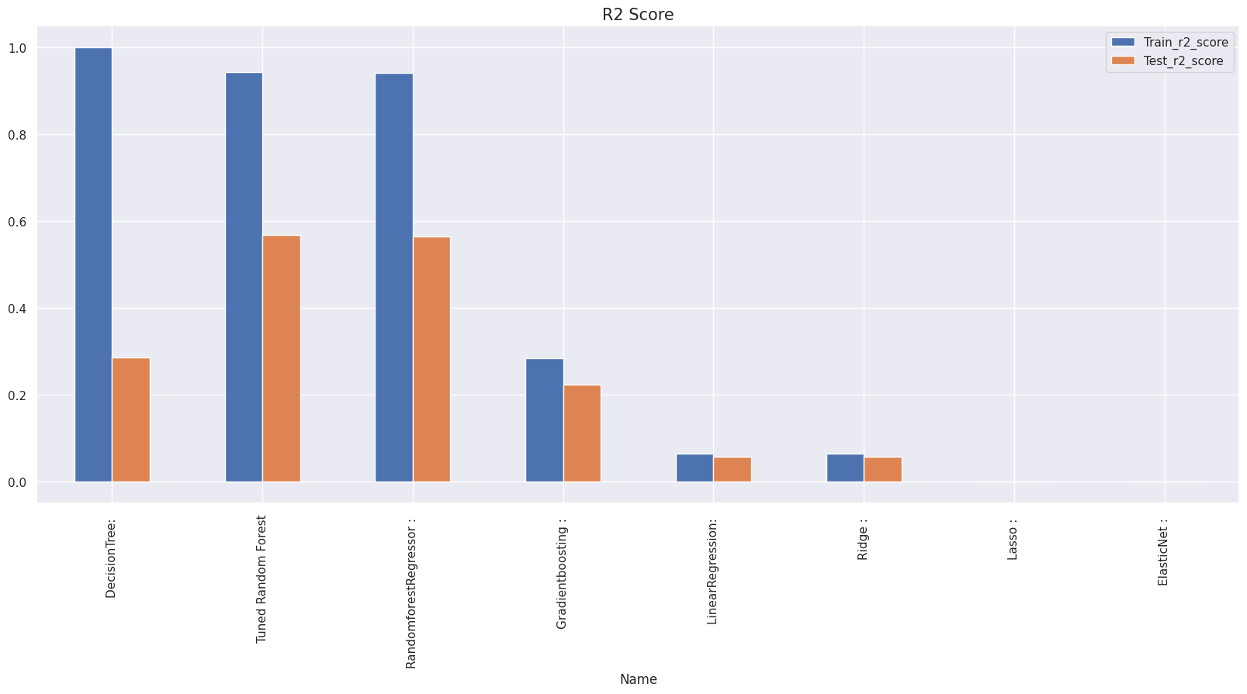
Result
* The Dataset does not contains null values ,but there is very less correlation between features and target variables.
* By fitting all the model get best score in Random Forest regressor , after tuning the hyper parameter using GridsearchCV, GET Train r2 score 0.94 and test r2 score 0.5622 because of improper dataset and less correlation between feature and target variable.
* The performance is low due to like:- no proper pattern of data, less correlation , not enough relevant features.

Slide 20
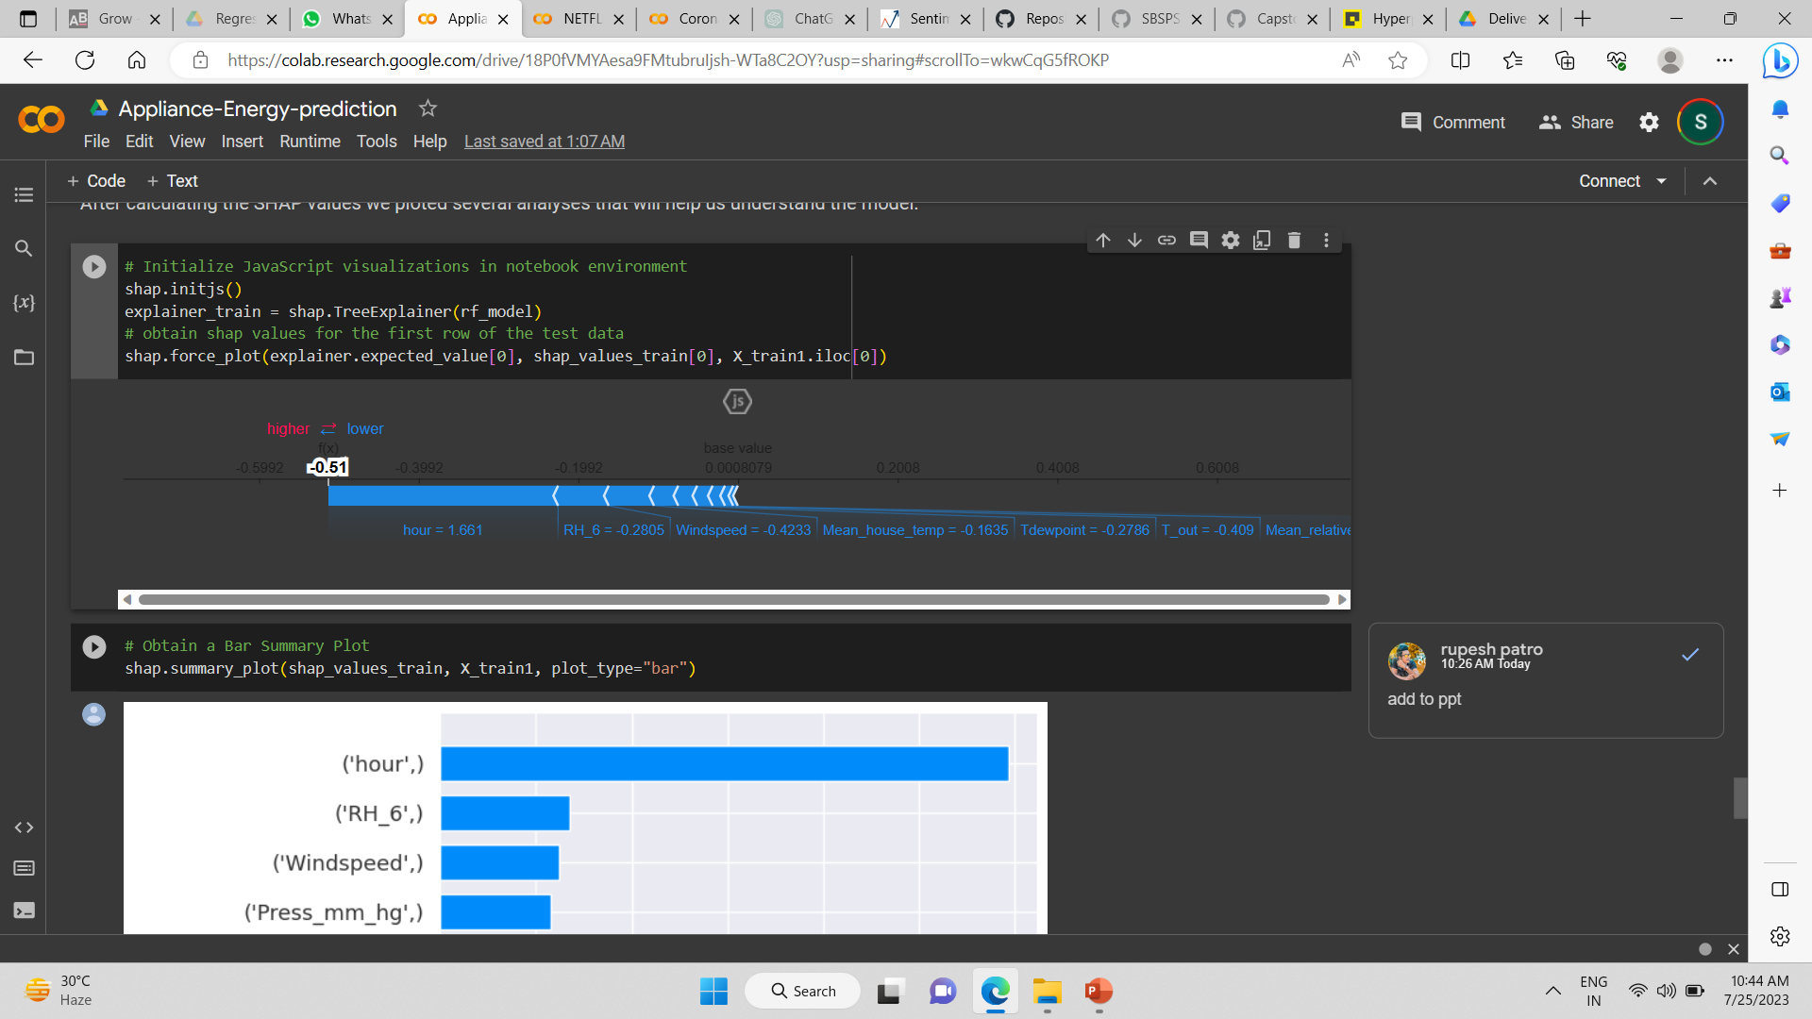
Model Explaination
We used Random Forest Regressor model as it has the most accurate prediction. This SHAP plot gives us the explainability of a single model prediction. Force plot can be used for error analysis, finding the explanation to specific instance prediction. The model is explained as follow:-
The model output value: -0.51
The base value: this is the value that would be predicted if we didn’t know any features for the current instance. The base value is the average of the model output over the training dataset
The numbers on the plot arrows are the value of the feature for this instance.
Red represents features that pushed the model score higher, and blue representing features that pushed the score lower.
The bigger the arrow, the bigger the impact of the feature on the output.
The amount of decrease or increase in the impact can be seen on the x-axis.

Slide 21
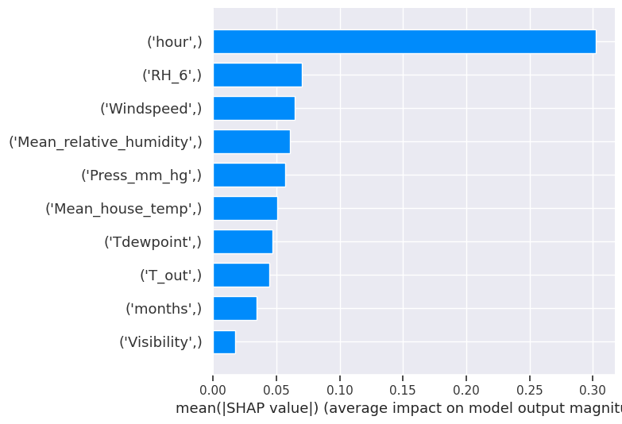
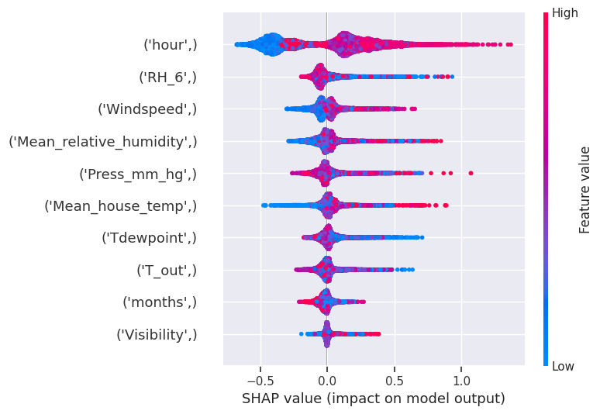
Bar Summary Plot
Dot Summary Plot

Slide 22
Conclus
ion
The most important determining factor for energy consumption is the hour of day.
Energy consumption is high in March and low in January, and a rise in temperature results in higher energy consumption.
As a feature, lights are extremely undervalued.
Decreased humidity leads to an increase in electricity consumption. Humidity is proportional to the dependent variable.
We have a high correlation with the dependent variable in the hours column, and many features have less than a 0.1 correlation with the dependent variable in the non linear dataset.
During the evening hours of 16:00 to 20:00, there is a high usage of electricity of more than 140Wh. Electricity use is highest on weekends (Saturdays and Sundays). (more than 25% higher than on weekdays)
The dataset has many outliers and no null values.
Many columns in the dataset are not normally distributed, and the target column is also right skewed.

Slide 23
Thank You

